Slide 1
CPSC 471 - Database Management Systems
Theatre Ticket Purchasing Database
February 17, 2023
Group 61
Jesse Desmarais
Saman Pordanesh
Quenten Welch

Slide 2
Introduction
- We want to make it possible for customers to buy movie tickets online for a chain of movie theatres. - Using a database for this will allow the theatre to:
~ Track how many seats are available for movie showings
~ Effectively schedule movies and showtimes
~ Track ticket purchasing patterns and how much money is being made on
ticket sales
- Customers will also have the ability to return tickets and have a modestly personalized user experience on the theatre’s ticket purchasing website.

Slide 3
Problem Definition
- The main issue is that without an online ticket purchasing option users do not know if tickets are available for their desired movie and showtime until they physically arrive at the theatre.
- Pre-packaged solutions for this issue are already available on the market.
- What we will try to do differently is offer a simpler, easy to understand user interface where the information the user requires is easy to see and it is quite clear what the user must do to purchase (or return) a ticket.
- We will also attempt to track a user’s favourite movies and their movie viewing history with the theatre chain to hopefully keep them engaged and keep them coming back to purchase more tickets.

Slide 4
Proposed Solution (What we will attempt to implement)
- Ticket Purchasing: User’s can purchase a ticket by choosing their desired theatre, movie, showtime, and seat.
- Cancelling Ticket: User’s can cancel a recently purchased ticket.
- Customer Subscription Service: User’s pay an annual subscription fee which qualifies them for early access to movie premieres, receipt of a regular newsletter, and various other perks as conceived by the theatre chain.
- Movie Search: Even if they do not purchase a ticket the curious customer can look for currently playing movies, their showtimes, the theatre they are showing at, and whether tickets are still available.

Slide 5
Proposed Solution (cont.)
- Account Management: Users can alter their personal account information.
- Seats: Each theatre will have a specific number of seats assigned to it, and customers will be able to see occupied and vacant seats then choose their desired seat when purchasing tickets.
- Administrator Account: Will allow theatre to add and remove currently playing movies, alter showtimes, monitor ticket purchasing information and profits, and edit/delete/add Customer accounts.
- General Customer Account: In addition to the subscription service account holder there will also be a general, free customer account. This will contain all the same functionality as a subscriber account except these users will not be able to add their favourite movies, receive the newsletter, or receive any extra perks.

Slide 6
Motivation
- To give customers an easy and stress-free movie-going experience.
~ Give them peace of mind that they will be able to watch a particular movie.
~ No worries that they will get to the theatre only to find out their desired
movie is sold out.
~ Allow them to track their movie-going experiences, thus bringing them back
to the ticket purchasing site more often.
- Making it easier for customers to purchase tickets and go to the movies will hopefully boost ticket sales and create loyal customers.

Slide 7
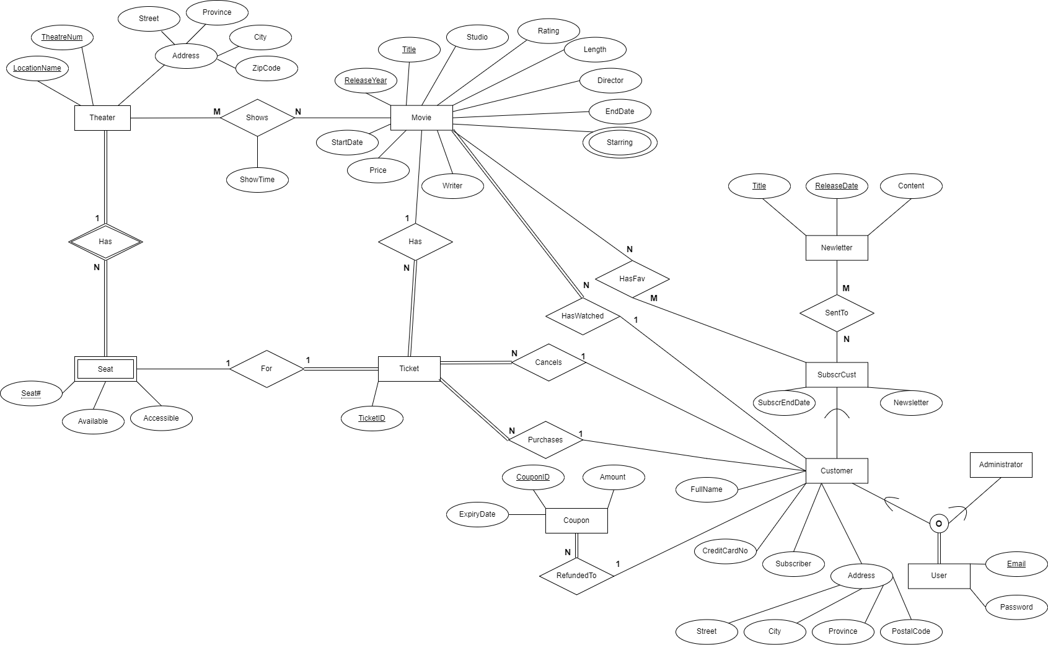
Enhanced Entity Relationship Diagram

Slide 8
Questions?
Suggestions?

